Slide 1
AI in Fabric
Enrich and transform data using Generative AI in Fabric

Slide 2
Agenda
01 Introduction
02 Connect AI Foundry to Fabric
03 AI Functions
04 AI Copilots
05 Data Wrangler
06 Anomaly Detection
07 AI Services in Fabric

Slide 3
01 Introduction to Fabric

Slide 4












Microsoft Fabric
The unified data platform for the era of AI
Data Factory
Data Engineering
Data Warehouse
Data Science
Real-Time Intelligence
Databases
Industry Solutions
Power BI
Copilot in Fabric
OneLake
Purview
UNIFIED
SaaS product experience
Security and governance
Compute and storage
Business model

Slide 5




Microsoft Fabric
End-to-end data science for business intelligence
Problem formulation and ideation
Modelling and experimentation
Predictive insights
SynapseML
Prepare
Model
Data discovery and pre-processing
Deployment and data enrichment
Explore
Evaluate

Slide 6
02 Connecting AI Foundry to Fabric

Slide 7
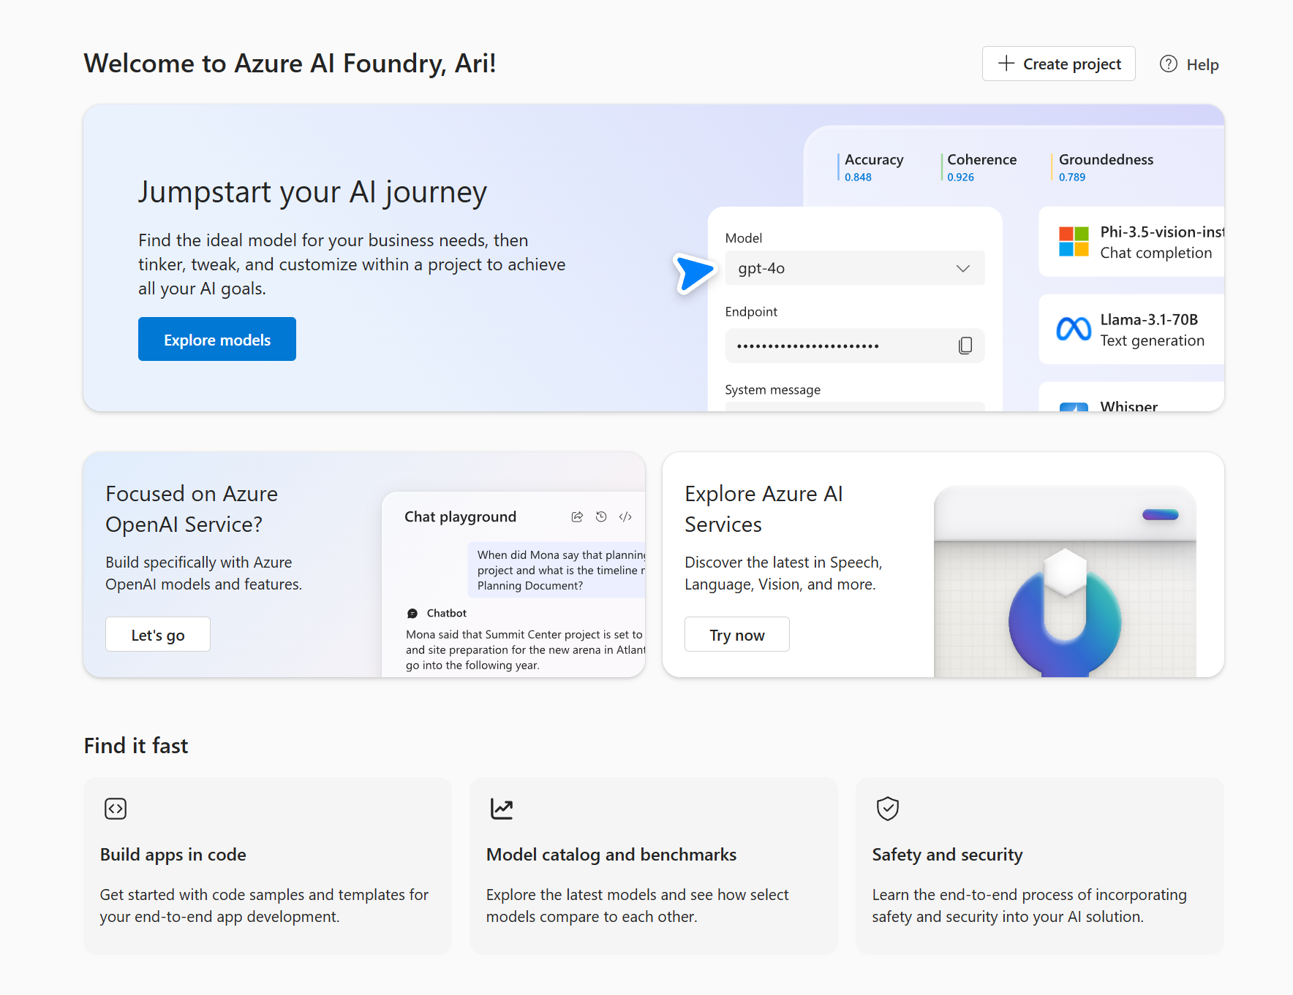
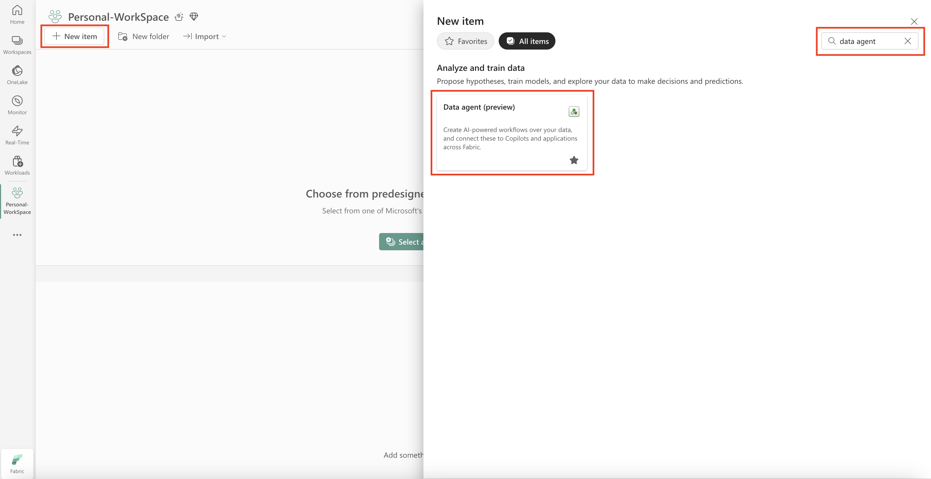
Connecting AI Foundry to Fabric
Fabric Data Agent

Slide 8
03 AI Functions in Fabric

Slide 9
Get started with AI functions today
Public preview
Announcement: aka.ms/ai-functions/blog
Documentation: aka.ms/ai-functions
Function | Description | Learn more
ai.similarity | Compare the meaning of input text with a single common text value or with pairwise values. | aka.ms/ai-functions/similarity
ai.classify | Classify input text values according to labels you choose. | aka.ms/ai-functions/classify
ai.analyze_sentiment | Identify the emotional state expressed by input text. | aka.ms/ai-functions/analyze-sentiment
ai.extract | Find and extract specific types of information from input text, for example locations or names. | aka.ms/ai-functions/extract
ai.fix_grammar | Correct the spelling, grammar, and punctuation of input text. | aka.ms/ai-functions/fix-grammar
ai.summarize | Get summaries of input text. | aka.ms/ai-functions/summarize
ai.translate | Translate input text into another language. | aka.ms/ai-functions/translate
ai.generate_response | Generate responses based on your own instructions. | aka.ms/ai-functions/generate-response

Slide 10
04 Copilots in Fabric

Slide 11


Copilot in every workload
Assistance for every experience and every data citizen
Public Preview
Public Preview
Public Preview
Public Preview
GA
GA
Data Factory
Data Warehouse
Data Engineering & Data Science
Databases
Real-Time Intelligence
Power BI
Generate code to transform data with ease—and get explanations to clarify complex tasks
Write and explain T-SQL queries or ask for suggestions and fixes while coding
Quickly generate notebook code to help work with Lakehouse data, suggest visualizations, and get insights
Write and explain T-SQL queries or ask for suggestions and fixes while coding
Translate questions into KQL queries that you can execute in real time
Quickly create report pages, get natural-language summaries, and generate synonyms

Slide 12
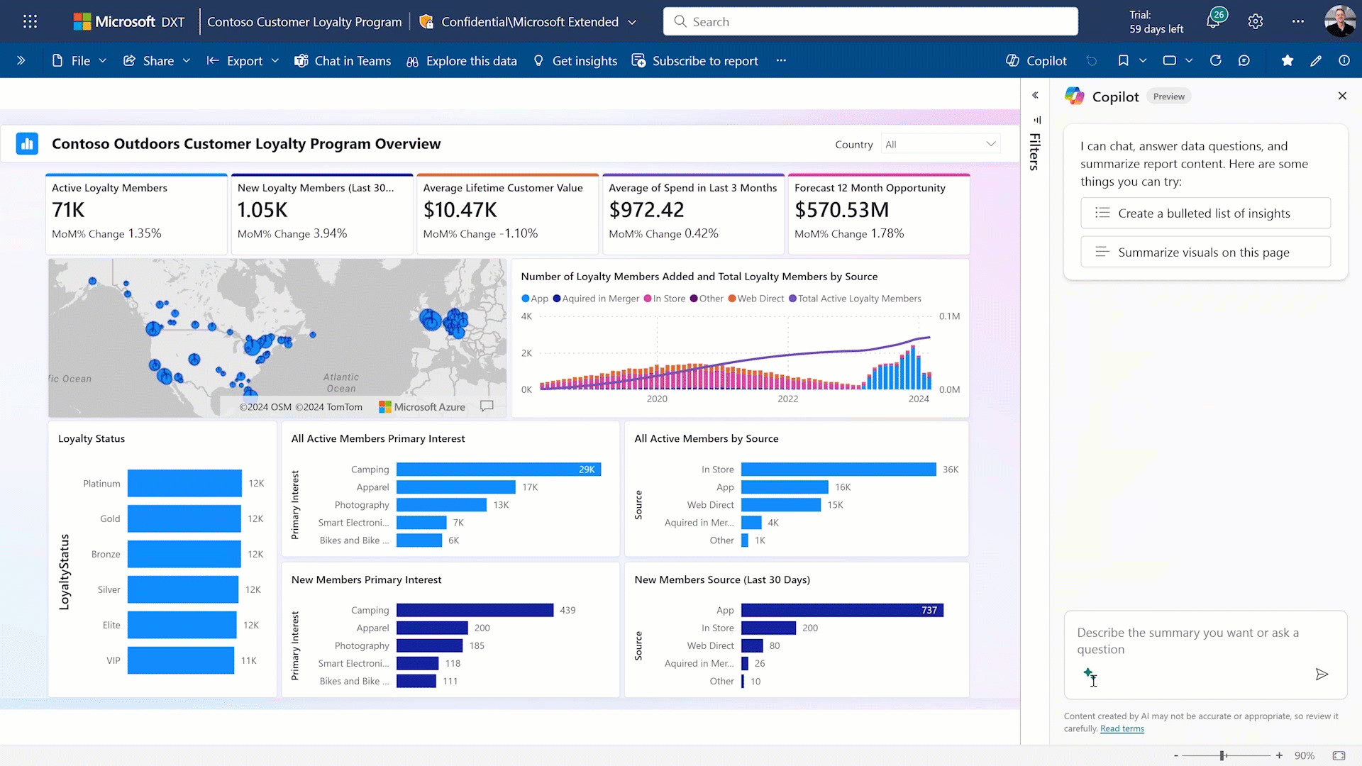
AI-driven insights for consumers
Copilot isn’t just for creators

Slide 13
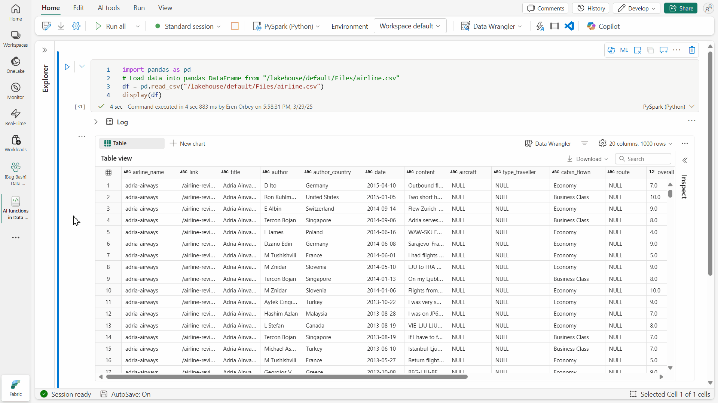
AI guidance in notebooks with Copilot
Public preview
Ask Copilot for help from a built-in chat pane with sample prompts to get started
Leverage Copilot directly from any code cell for a more natural developer experience
Use quick actions to explain, optimize, and document code
Debug Python or PySpark logic with just a few clicks

Slide 14
05 Data Wrangler in Fabric

Slide 15
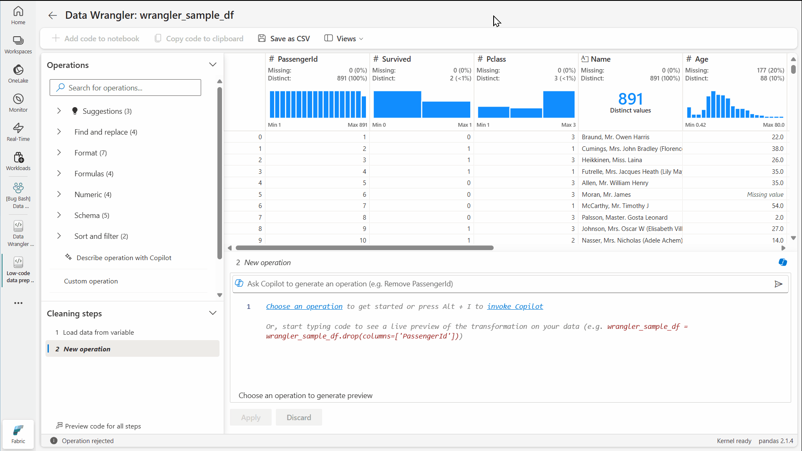
AI-powered analysis with Data Wrangler
Coming soon
Explore data in a dynamic, Excel-like interface with live stats and visualizations
Browse and apply data-cleaning operations with AI suggestions
Ask Copilot to generate code based on your descriptions
Automatically convert custom code from pandas to PySpark

Slide 16
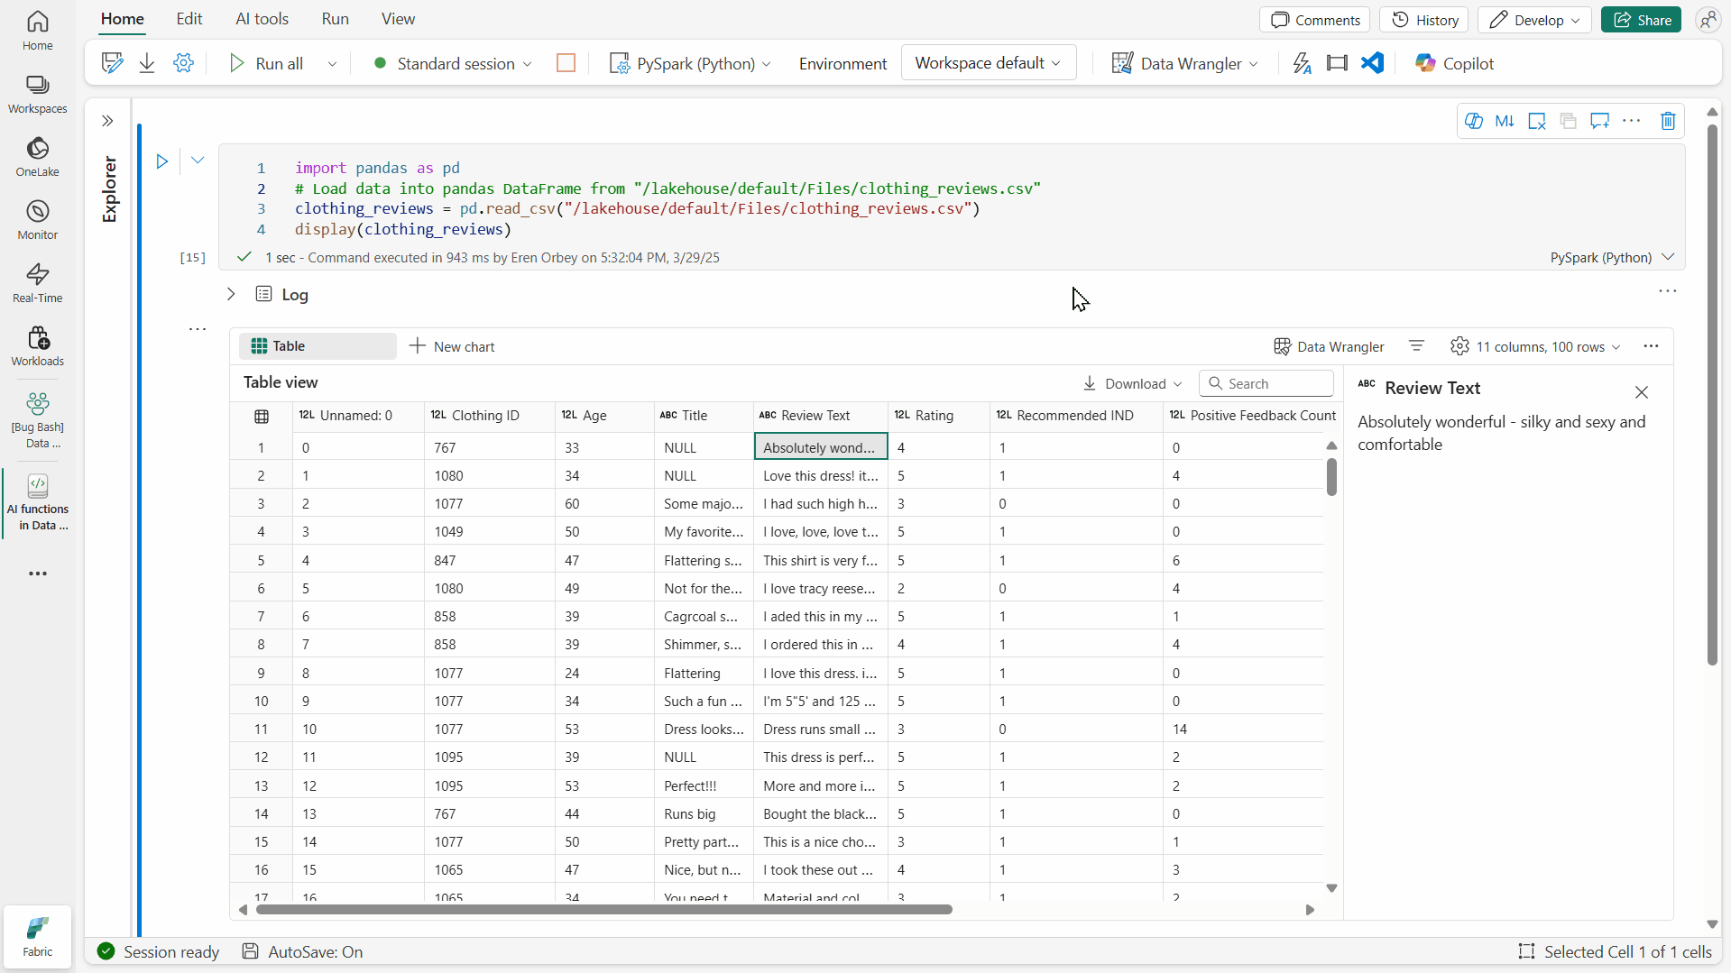
Seamless data enrichment with AI functions
Public preview
Transform pandas or Spark DataFrames with GenAI using just a single line of code
Choose from summarization, classification, custom text generation, and much more
Coming soon:
AI functions in SQL for Data Warehousing
AI functions in Data Wrangler for low-code GenAI data prep

Slide 17
The future of AI functions in Fabric
Coming soon
New availability for Fabric customers using smaller than F64 SKUs
LLM upgrades for Fabric’s built-in AI endpoint (GPT-3.5 → GPT-4o mini)
More flexibility for custom tasks
Few-shot examples for ai.classify
Lists of entities returned from ai.extract
Seamless integrations across Fabric engines and experiences
AI functions with SQL in Data Warehousing
AI functions with a low-code UX in Data Wrangler
AI functions with a low-code UX in Dataflows

Slide 18
06 Anomaly Detection in Fabric

Slide 19
07 AI Services in Fabric

Slide 20
AI services in Fabric
Azure AI services help developers and organizations rapidly create intelligent, cutting-edge, market-ready, and responsible application. with prebuilt and customizable APIs and models.
Fabric provides two options to use Azure AI services:
Pre-built AI models in Fabric (preview)
Fabric seamlessly integrates with Azure AI services, allowing you to enrich your data with prebuilt AI models without any prerequisite. We recommend this option because you can use your Fabric authentication to access AI services, and all usages are billed against your Fabric capacity. This option is currently in public preview, with limited AI services available.
Fabric offers Azure OpenAI Service, Text Analytics, and Azure AI Translator by default, with support for both SynapseML and the RESTful API. You can also use the OpenAI Python Library to access Azure OpenAI service in Fabric. For more information about available models, visit prebuilt AI models in Fabric.
Bring your own key (BYOK)
You can provision your AI services on Azure and bring your own key to use them from Fabric. If the prebuilt AI models don't yet support the desired AI services, you can still use BYOK (Bring your own key).
To learn more about how to use Azure AI services with BYOK, visit Azure AI services in SynapseML with bring your own key.

Slide 21
Resources
Overview of Copilot for Data Science and Data Engineering in Microsoft Fabric
Create a Fabric data agent
Accelerate data prep with Data Wrangler
Develop, execute, and manage notebooks
Transform and enrich data seamlessly with AI functions
Empowering agentic AI by integrating Fabric with Azure AI Foundry
Use Azure AI services in Fabric

Slide 22
Thank you

Slide 23
???

Slide 24
???

Slide 25
Powered by AI
Gen AI accelerates your data journey in Fabric
Copilot-accelerated experiences
AI-driven insights
Custom GenAI for your data

